Slide 1
Contact Angle and Contact radius

Slide 2
Droplet volume
当体积比较大的时候，spherical cap 和实际体积有很大偏差. 在CCR部分不适用， 在CCA部分合适。

Slide 3
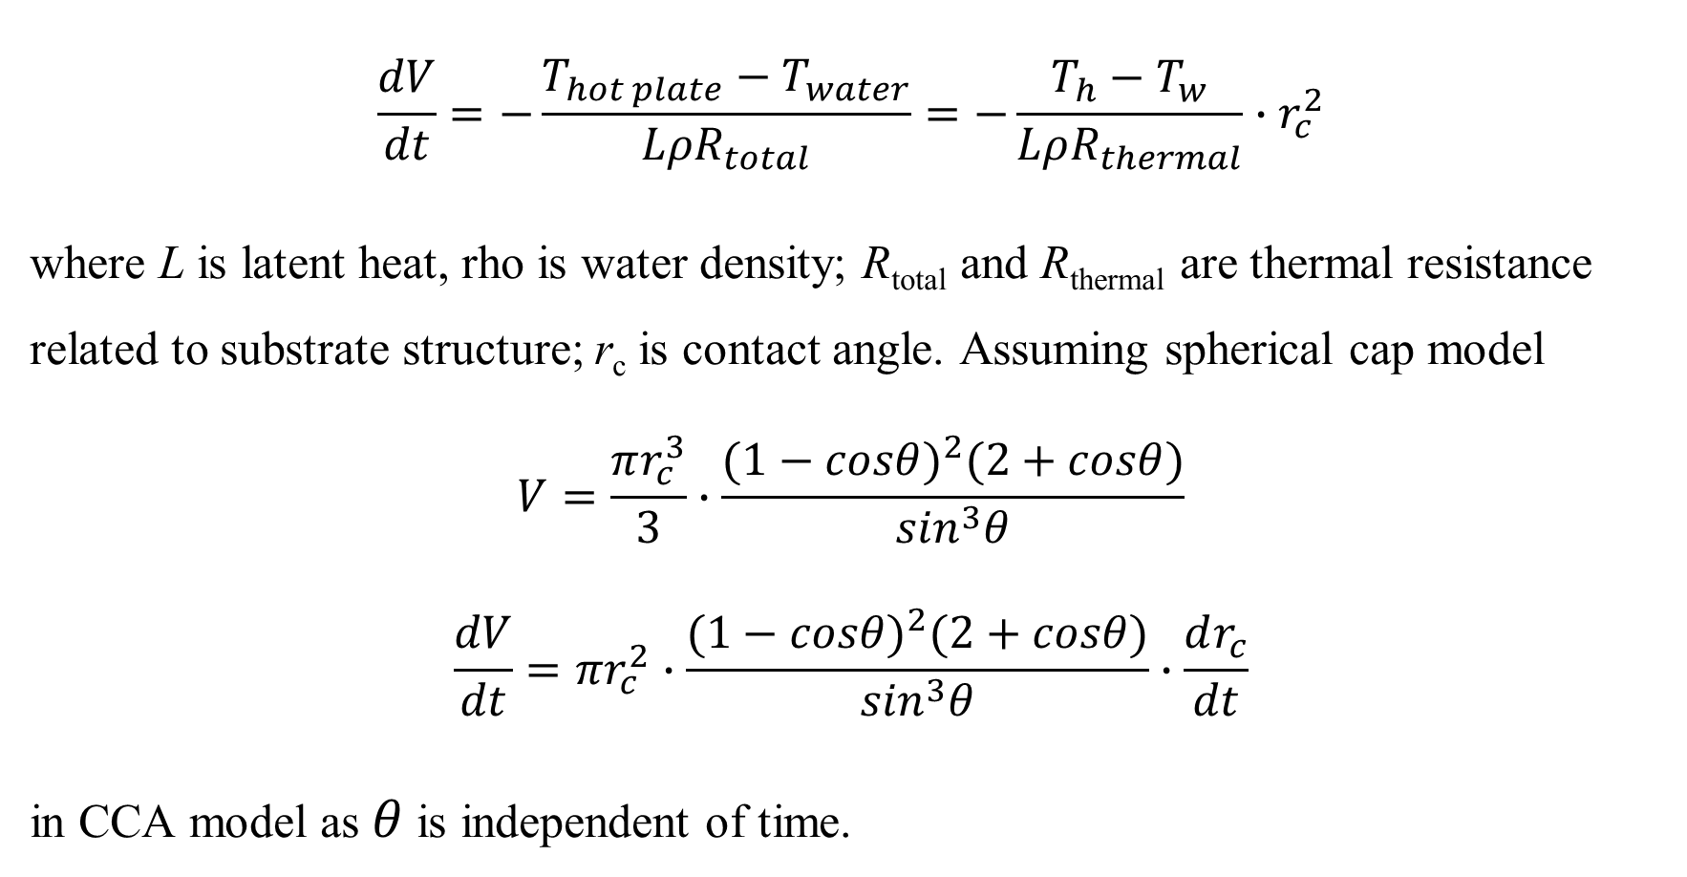
Evaporation equation
$$\frac{dV}{dt}=−\frac{T_{hot plate}−T_{water}}{LρR_{total}}=−\frac{T_{h}−T_{w}}{LρR_{thermal}}∙r_{c}^{2}$$
where L is latent heat, rho is water density; R_{total} and R_{thermal} are thermal resistance related to substrate structure; r_{c} is contact angle. Assuming spherical cap model
$$V=\frac{πr_{c}^{3}}{3}∙\frac{{(1−cosθ)}^{2}(2+cosθ)}{\sin^{3}θ}$$
$$\frac{dV}{dt}=πr_{c}^{2}∙\frac{{(1−cosθ)}^{2}(2+cosθ)}{\sin^{3}θ}∙\frac{dr_{c}^{ }}{dt}$$
in CCA model as$θ$ is independent of time.

Slide 4
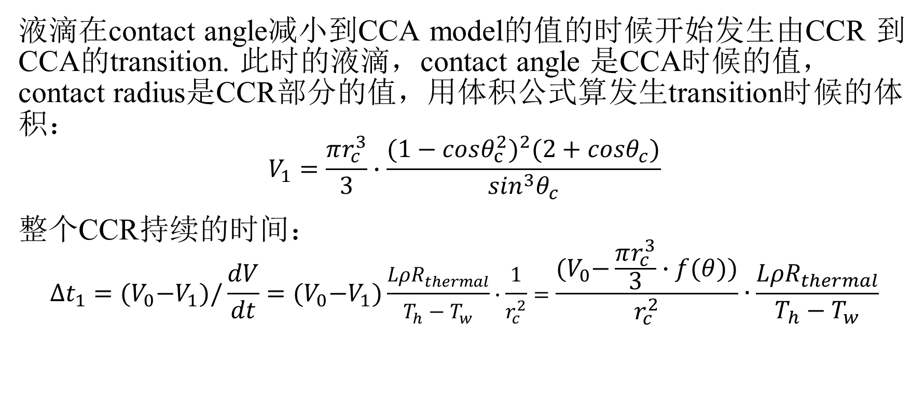
CCR part
液滴在contact angle减小到CCA model的值的时候开始发生由CCR 到CCA的transition. 此时的液滴，contact angle 是CCA时候的值，contact radius是CCR部分的值，用体积公式算发生transition时候的体积：
$$V_{1}=\frac{πr_{c}^{3}}{3}∙\frac{{(1−cosθ_{c}^{2})}^{2}(2+cosθ_{c})}{\sin^{3}θ_{c}}$$
整个CCR持续的时间：
$$∆t_{1}={(V}_{0}−V_{1})/\frac{dV}{dt}={(V}_{0}−V_{1})\frac{LρR_{thermal}}{T_{h}−T_{w}}∙\frac{1}{r_{c}^{2}}=\frac{{(V}_{0}−\frac{πr_{c}^{3}}{3}∙f(θ))}{r_{c}^{2}}∙\frac{LρR_{thermal}}{T_{h}−T_{w}}$$

Slide 5
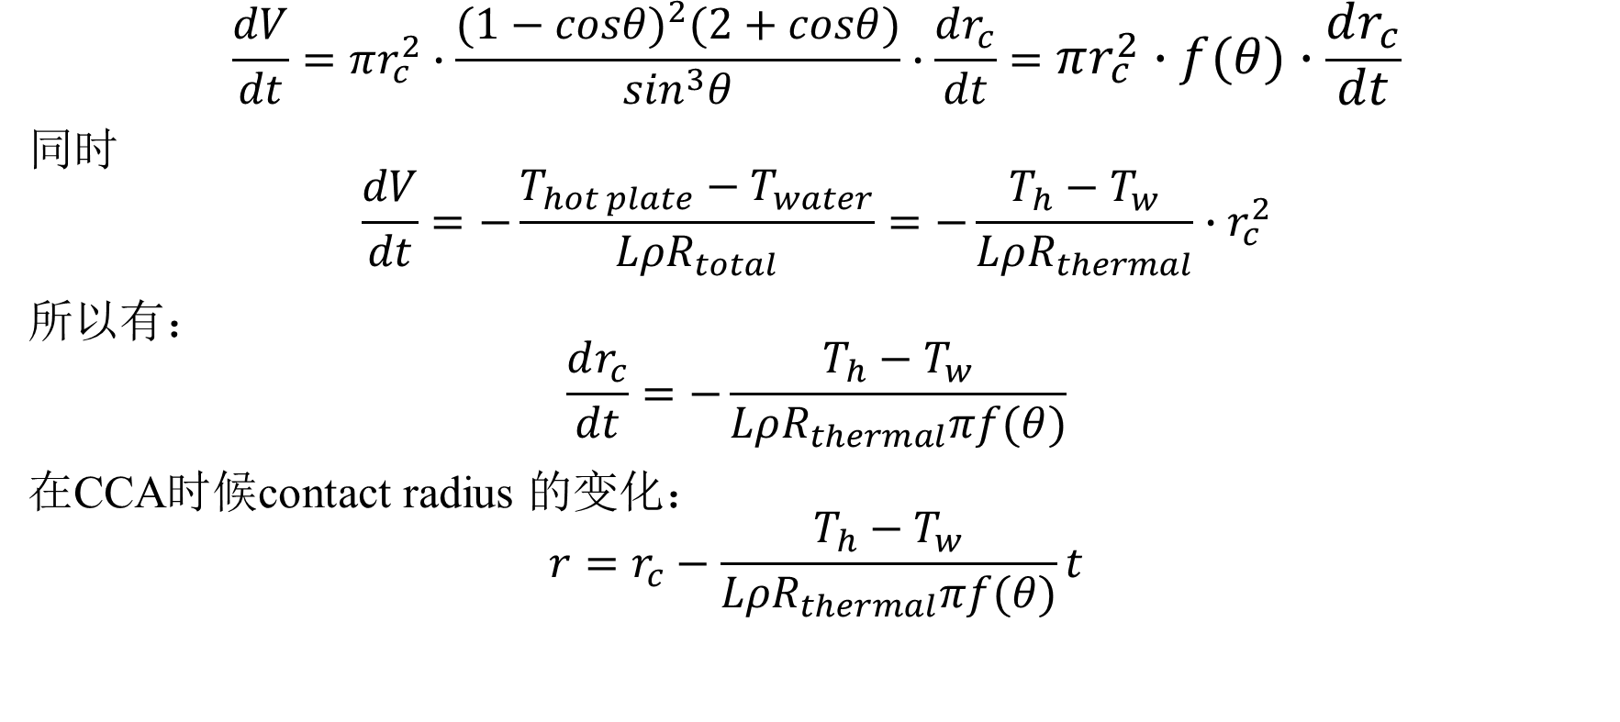
CCA part
$$\frac{dV}{dt}=πr_{c}^{2}∙\frac{{(1−cosθ)}^{2}(2+cosθ)}{\sin^{3}θ}∙\frac{dr_{c}^{ }}{dt}=πr_{c}^{2}∙f(θ)∙\frac{dr_{c}^{ }}{dt}$$
同时
$$\frac{dV}{dt}=−\frac{T_{hot plate}−T_{water}}{LρR_{total}}=−\frac{T_{h}−T_{w}}{LρR_{thermal}}∙r_{c}^{2}$$
所以有：
$$\frac{dr_{c}^{ }}{dt}=−\frac{T_{h}−T_{w}}{LρR_{thermal}πf(θ)}$$
在CCA时候contact radius 的变化：
$$r=r_{c}^{ }−\frac{T_{h}−T_{w}}{LρR_{thermal}πf(θ)}t$$

Slide 6

Contact radius
可以预测contact radius 的表达式
$$r=r_{c } 0<t<∆t_{1}$$
$r=r_{c}^{ }−\frac{T_{h}−T_{w}}{LρR_{thermal}πf\left(θ\right)}t t>∆t_{1}$
$$∆t_{1}=\frac{{(V}_{0}−\frac{πr_{c}^{3}}{3}∙f(θ))}{r_{c}^{2}}∙\frac{LρR_{thermal}}{T_{h}−T_{w}}$$
同时也能计算出CCA持续的时间，忽略最后的mix model：
$$∆t_{2}=\frac{r_{c}^{ }LρR_{thermal}πf\left(θ\right)}{T_{h}−T_{w}}$$

Slide 7
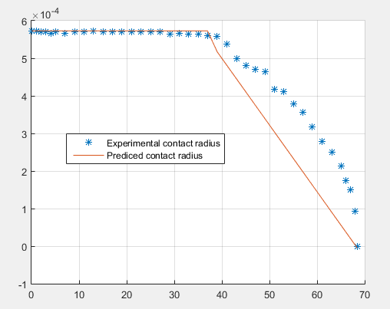
Comparing of predicted contact radius

Slide 8
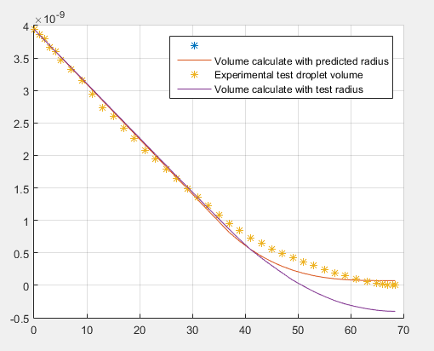
Droplet volume with predicted contact radius

Slide 9
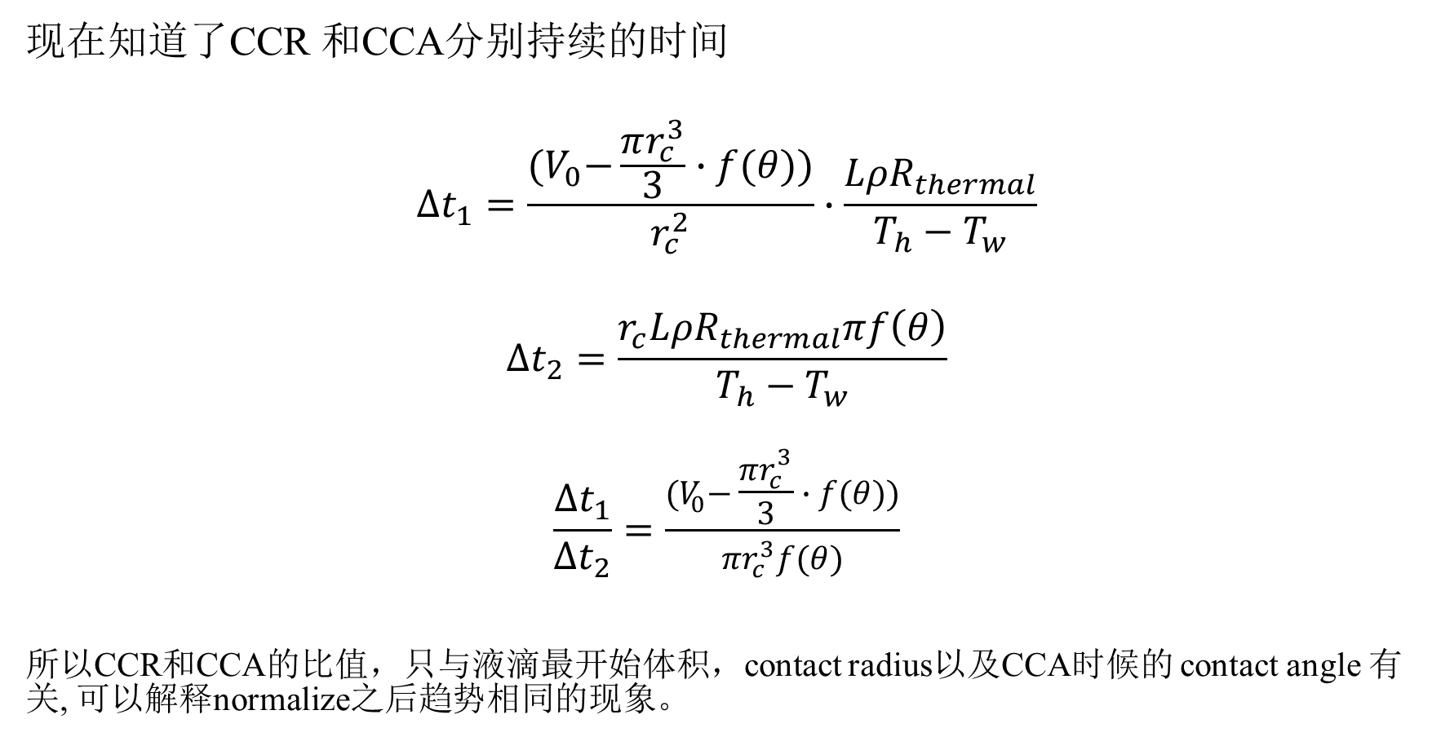
Ratio of CCR and CCA
现在知道了CCR 和CCA分别持续的时间
$$∆t_{1}=\frac{{(V}_{0}−\frac{πr_{c}^{3}}{3}∙f(θ))}{r_{c}^{2}}∙\frac{LρR_{thermal}}{T_{h}−T_{w}}$$
$$∆t_{2}=\frac{r_{c}^{ }LρR_{thermal}πf\left(θ\right)}{T_{h}−T_{w}}$$
$$\frac{∆t_{1}}{∆t_{2}}=\frac{{(V}_{0}−\frac{πr_{c}^{3}}{3}∙f(θ))}{{πr}_{c}^{3}f(θ)}$$
所以CCR和CCA的比值，只与液滴最开始体积，contact radius以及CCA时候的 contact angle 有关, 可以解释normalize之后趋势相同的现象。

Slide 10
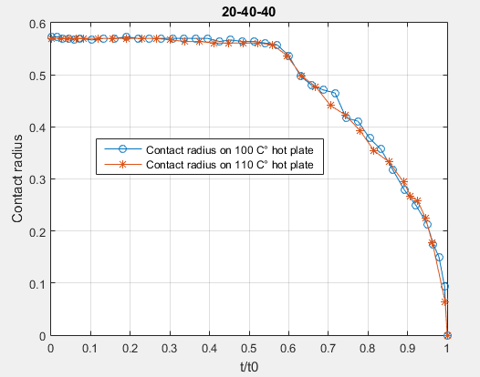
Normalize

